Slide 1
: Group project : Done by:- biplab chattaraj(203002485310002) debsankar mitra(203002485310018) krishnendu joardar(203002485310017) md zeeshan ali(203002485310012)
Real-Time Air Quality Monitoring System Based on IOT
SUPERVISED BY : KAMALIKA BHATTACHARJYA

Slide 2

CONTENTS :-
1. Introduction.
2. Required Components.
3. Circuit Diagram.
4. Hardware & Software requirements.
5. Arduino board.
6. Working Explanation.
7. Advantages.
8. Future scope.
9. Conclusion.

Slide 3
1) INTRODUCTION :-
In this project we are going to make an IOT Based Air Pollution Monitoring System in which we will monitor the Air Quality over a webserver using internet and will trigger a alarm when the air quality goes down beyond a certain level, means when there are sufficient amount of harmful gases are present in the air like CO2, smoke, alcohol, benzene and NH3. It will show the air quality in PPM on the LCD and as well as on webpage so that we can monitor it very easily.

Slide 4
In this project we have used MQ135 sensor as the air quality sensor which is the best choice for monitoring Air Quality as it can detects most harmful gases and can measure their amount accurately. In this IOT project, we can monitor the pollution level from anywhere using computer or mobile. We can install this system anywhere and can also trigger some device when pollution goes beyond some level, like we can switch on the Exhaust fan or can send alert SMS/mail to the user.

Slide 5
2) Required Components :-
MQ135 Gas sensor.
Arduino Uno.
Wi-Fi module ESP8266.
16X2 LCD.
Breadboard.
10K potentiometer.
1K ohm resistors.
220 ohm resistor.
Buzzer.

Slide 6
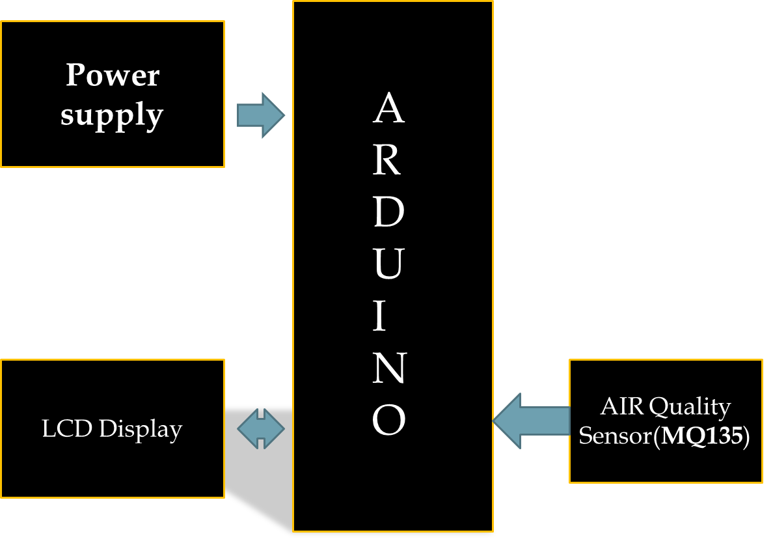
3)Circuit Diagram and Explanation:-

Slide 7
Making Process :-
First of all we will connect the ESP8266 with the Arduino. ESP8266 runs on 3.3V and if you will give it 5V from the Arduino then it won’t work properly and it may get damage. Connect the VCC and the CH_PD to the 3.3V pin of Arduino. The RX pin of ESP8266 works on 3.3V and it will not communicate with the Arduino when we will connect it directly to the Arduino. So, we will have to make a voltage divider for it which will convert the 5V into 3.3V. This can be done by connecting three resistors in series like we did in the circuit. Connect the TX pin of the ESP8266 to the pin 10 of the Arduino and the RX pin of the esp8266 to the pin 9 of Arduino through the resistors.

Slide 8
4) Hardware & Software requirements :-
ESP8266 Wi-Fi module gives your projects access to Wi-Fi or internet. It is a very cheap device and make your projects very powerful. It can communicate with any microcontroller and it is the most leading devices in the IOT platform.
Then we will connect the MQ135 sensor with the Arduino. Connect the VCC and the ground pin of the sensor to the 5V and ground of the Arduino and the Analog pin of sensor to the A0 of the Arduino.

Slide 9
Connect a buzzer to the pin 8 of the Arduino which will start to beep when the condition becomes true.
In last, we will connect the LCD with the Arduino.

Slide 10
The connections of the LCD are as follows :-
Connect pin 1 (VEE) to the ground.
Connect pin 2 (VDD or VCC) to the 5V.
Connect pin 3 (V0) to the middle pin of the 10K potentiometer and connect the other two ends of the potentiometer to the VCC and the GND. The potentiometer is used to control the screen contrast of the LCD. Potentiometer of values other than 10K will work too.

Slide 11
Connect pin 4 (RS) to the pin 12 of the Arduino.
Connect pin 5 (Read/Write) to the ground of Arduino. This pin is not often used so we will connect it to the ground.
Connect pin 6 (E) to the pin 11 of the Arduino. The RS and E pin are the control pins which are used to send data and characters.
The following four pins are data pins which are used to communicate with the Arduino.

Slide 12
Connect pin 11 (D4) to pin 5 of Arduino.
Connect pin 12 (D5) to pin 4 of Arduino.
Connect pin 13 (D6) to pin 3 of Arduino.
Connect pin 14 (D7) to pin 2 of Arduino.
Connect pin 15 to the VCC through the 220 ohm resistor. The resistor will be used to set the back light brightness. Larger values will make the back light much more darker.
Connect pin 16 to the Ground.

Slide 13
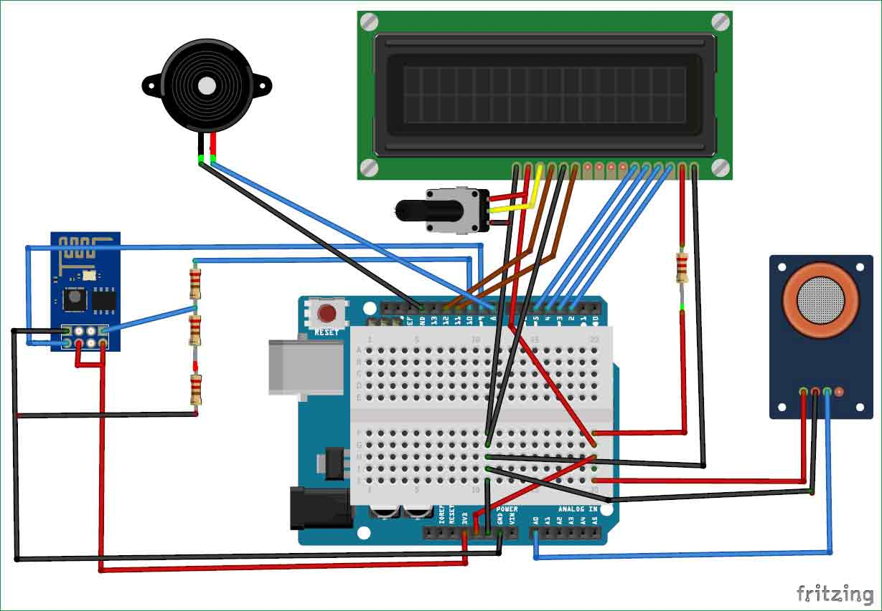
IOT AIR QUALITY MONITERING SYSTEM USING ARDUINO CIRCUIT

Slide 14
5) Arduino board :-
Arduino is open-source hardware.
An Arduino board consists of an Atmel 8-, 16- or 32-bit AVR microcontroller (ATmega8, ATmega168, ATmega328, ATmega1280, ATmega2560).
Arduino microcontrollers are pre-programmed with a boot loader that simplifies uploading of programs to the on-chip flash memory.
Boards are loaded with program code via a serial connection to computer.
The Arduino board exposes most of the microcontroller's I/O pins for use by other circuits.

Slide 15
6) Working Explanation :-
The MQ135 sensor can sense NH3, NOx, alcohol, Benzene, smoke, CO2 and some other gases, so it is perfect gas sensor for our Air Quality Monitoring Project. When we will connect it to Arduino then it will sense the gases, and we will get the Pollution level in PPM (parts per million). MQ135 gas sensor gives the output in form of voltage levels and we need to convert it into PPM.

Slide 16
Sensor was giving us value of 90 when there was no gas near it and the safe level of air quality is 350 PPM and it should not exceed 1000 PPM. When it exceeds the limit of 1000 PPM, then it starts cause Headaches, sleepiness and stagnant, stale, stuffy air and if exceeds beyond 2000 PPM then it can cause increased heart rate and many other diseases.
When the value will be less than 1000 PPM, then the LCD and webpage will display “Fresh Air”. Whenever the value will increase 1000 PPM, then the buzzer will start beeping and the LCD and webpage will display “Poor Air, Open Windows”. If it will increase 2000 then the buzzer will keep beeping and the LCD and webpage will display “Danger! Move to fresh Air”.

Slide 17
7) Advantages :-
Gas Sensor(MQ135) module is useful for monitoring Air Quality . And these Sensors are easily available.
Detecting a wide range gases like NH3, NOx, alcohol, Benzene, smoke, CO2 etc.
The Air monitoring system is very Simple , compact and easily handle.

Slide 18
8) Future scope :-
In future the project can be upgraded in more ways than one.
Interface more no. of sensors to know gases present in air.
Design webpage and upload data on webpage.
Interface SD CARD to store data.
Interface GPS module to monitor the pollution.

Slide 19
9) Conclusion :-
The system to monitor the air of environment using arduino micro controller.
IOT technology proposed to improve quality of air.
Gas sensor gives the sense of different type of dangerous gases.
It supports new technology and healthy life concept.

Slide 20
Thank you

